Slide 1
MN10500 Corporate Finance For Managers
Semester 2_2020-2021
Dr Weixi (Louis) Liu
Office: Wessex House 9.38
Email: w.liu@bath.ac.uk
Notes:
https://www.bloomberg.com/news/articles/2017-02-07/disney-s-iger-willing-to-stay-as-ceo-beyond-contract
https://www.bloomberg.com/news/videos/2017-02-08/disney-s-iger-will-do-what-s-best-for-company

Slide 2
About the Module
Core Text:
Brealey, Myers & Allen, Principles of Corporate Finance (12/E), McGraw Hill
Supplementary Text:
Hillier, Grinblatt and Titman, Financial Markets and Corporate Strategy (European Edition), McGraw Hill
+ non-technical academic articles in some lecture topics
Lectures:
Pre-recorded lectures on Moodle/Panopto
Bi-weekly live drop-in Q&A sessions: 10.15 am Wednesdays
Tutorials:
Bi-weekly live seminar sessions according to individual timetables

Slide 3
Friendly Reminders…
Please take opportunities to interact with the lecturer and tutor during the live drop-in and seminar sessions
Primary access of course announcement/materials: Moodle + (not always) email reminders
Do your preparation
Work on seminar exercises + quiz questions on Moodle
Your feedback always appreciated!

Slide 4
Lectures
Pre-recorded lectures (from 2019)
Bi-weekly LOIL (Live Online Interactive Learning) sessions for Q&A with the lecturer
Please post your questions on the dedicated “Q&A Forum” (not News Forum) on Moodle or email me BEFORE each session
Supporting materials:
Lecture notes
Video clips on business cases
Articles that help you to understand important concepts
MCQ Moodle quiz for each lecture topic

Slide 5
Seminars
Bi-weekly LOIL sessions led by seminar tutor
Each seminar covers the previous TWO lecture topics (e.g. Seminar 1 covers Lectures 1 & 2)
Solutions, and recordings (of the tutor working through each question) to be uploaded on Moodle after the last seminar group, so
Please try your best attempting the questions

Slide 6
As Lecturer I will…
Provide weekly lecture recording(s) and resources for the lecture in advance
Provide you with other supporting documents on an on-going basis
Respond to emails normally within 48 hours
Respect individuals learning needs
Offer support where needed

Slide 7
Assessment
Concept + numerical type of questions
Online open-book final examination via Inspera (100%)
Provisional arrangement only, full details will be available later this semester
‘Bigger’ questions (calculation + essay)
‘Depth’ of knowledge
Notes:
Please note that all exam arrangements are subject to changes given the prevailing COVID situation and relevant national/university policies.

Slide 8
Support that makes you well-prepared for the assessments
(Of course!) lecture notes, seminar questions and Moodle quiz
Panopto recording on Moodle
Textbook as supplement
Dedicated revision document, with specimen questions if necessary
Past exam papers
Final exam: 2017/8 onwards on Library website
Solutions (if available) provided in line with SoM policy
Please note the different format of the online 2019/20 paper
Your discretion very important!

Slide 9
Course Outline
Week | Topics | LOIL Session Arrangement
19 | Basics of corporation | Drop-in session
20 | The Time Value of Money | Seminar 1
21 | Valuing Bonds and Stocks | Drop-in session
22 | Investment Decision Rules | Seminar 2
23 | Risk and Return | Drop-in session
24 | The Cost of Capital | Seminar 3
25 | Introduction to Corporate Financing and Capital Structure in a Perfect Market | Drop-in session
26 | Debt Policy and Optimal Capital Structure | Seminar 4
 | Easter Vacation
29 | Dividend and Payout Policy | Drop-in session
30 | Working Capital Management | Seminar 5
31 | Revision lecture | Drop-in session
32 | Revision (self-study) | Drop-in session

Slide 10
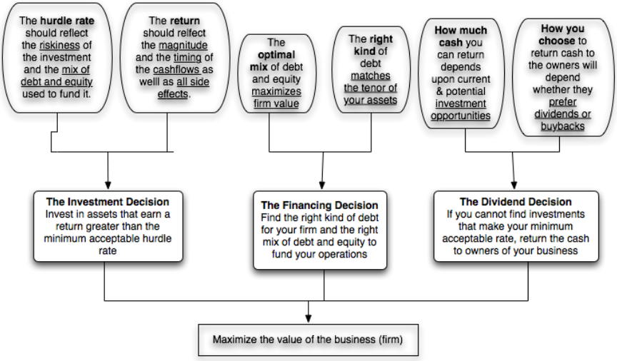
The Big Picture

Slide 11
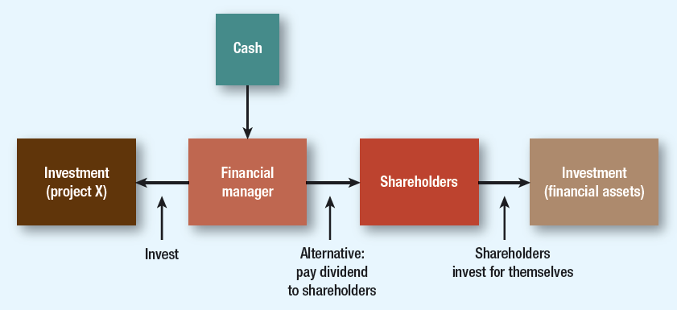
A Simpler View…

Slide 12
Lecture 1 Basics of corporation

Slide 13
Reading
BMA: Chapter 1
An interesting case:
Consultancy spend at Co-operative Group ‘feral’, tribunal hears (http://www.thenews.coop/101044/news/business/consultancy-spend-co-operative-group-feral-tribunal-hears/)

Slide 14
Learning Outcomes
Define different types of business entities
Differentiate corporate investment and financing decisions
Justify the goals of corporate managers
Discuss the potential conflicts of interests between corporate owners and controllers
List good practices of corporate governance

Slide 15
The Population by Legal Forms
Source: U.S. Census 2015 SUSB Annual Data & 2019 UK Business Population Estimates
Notes:
Majority of partnerships and sole prop have no employees.

Slide 16
Investment and Financing Decisions
The Investment Decision
Real Assets: capital budgeting or ‘CAPEX’ decision
Tangible/intangible assets
The Financing Decision
Financial Assets
Choice between alternative forms of financing: capital structure

Slide 17
Example: Investment and Financing Decisions
Are the following capital budgeting or financing decisions?
Apple decides to spend $500 million to develop a new iPhone.
GE borrows $400 million from bond investors.
Microsoft issues 100 million shares to buy a small technology company.

Slide 18
What is a Corporation
Corporation-A business organized as a separate legal entity owned by shareholders
Sum of all ownership value is called equity.
No limit to the number of shareholders, and thus the amount of funds a company can raise by selling shares.
Owner (shareholder) is entitled to dividend payments
Shareholders have limited liability
Types of Corporations:
Public Corporations
Private Corporations

Slide 19
Corporation: Pros and Cons
Benefits
Limited liability
Infinite lifespan
Ease of raising capital
Drawbacks
Double taxation
“Agency Problems”

Slide 20
Role of Financial Manager
(2)
(1)
Firm's
Financial
Financial
operations
manager
(4a)
markets
(3)
(4b)
(1) Cash raised from investors
(2) Cash invested in firm
(3) Cash generated by operations
(4a) Cash reinvested
(4b) Cash returned to investors
Notes:
Explain the critical role of the financial manager in obtaining funds from financial markets to fulfill the needs of the firm. Be certain to provide the big picture. Explain the cash flows shown in the slide. Explain how cash is generated from operations. Explain how this slide helps in understanding the role of the financial manager. The financial manager must learn to value real and financial assets. The financial manager must understand how financial markets work, for it is there that value is ultimately determined. Also explain the cash flow cycle as given in the diagram.

Slide 21
Goals of the Corporation
In traditional corporate finance, the objective in decision making is to maximize the value of the firm.
A narrower objective is to maximize shareholder wealth. When the stock/share is traded and markets are viewed to be efficient, the objective is to maximize the stock price.
Maximize equity value
Maximize market estimate of equity value
Maximize firm value
Notes:
Use a cow farmer example…
Share price is an unbiased (might be wrong) estimate of shareholder wealth.
Maximise employee/customer satisfaction are all by-product of value maximisation.

Slide 22
Agency Problems
Do managers really maximise value?
Ethics in value maximisation
Agency Problems
Shareholders desire wealth maximization
Managers are agents for stockholders, but the managers may act in their own interests rather than maximizing value
Notes:
Share price maximization doesn’t make a company social outlaw.
https://www.youtube.com/watch?v=u-yForoAZ3U
An excellent follow-up to the debate between shareholders and stakeholders is the debate between shareholders and managers. Here it is worth noting the source of true power. In fact, it is important to highlight the fact that owners of a public corporation have very little power relative to managers. Examples of state corporate law can be presented to show the limited influence shareholders have over managers.
Agency Problem – Managers are agents for stockholders, but the managers may act in their own interests rather than maximizing value.
Stakeholder – anyone with a financial interest in the firm.
Note: Managers may act in ways that are not in the best interests of shareholders. This is known as an “agency problem.”
Note: Shareholders want managers to maximize the market value of the firm. However, managers are often obliged to appease not only the shareholders but all of the stakeholders as well.

Slide 23
Corporate Ownership vs. Control
Difference in Information
Different Objectives
In theory: Shareholders have significant control over management.
In practice: managers usually have information advantage on:
Stock prices and returns
Issues of shares and other securities
Dividends
Financing
Managers do not always attempt to maximize firm value and
Shareholders incur costs to monitor the managers and constrain their actions

Slide 24
Disciplinary Mechanisms and Their Effectiveness
Annual Meetings
Board of Directors
In theory: a venue for stockholders to vote on managers and management decisions.
In practice: power significantly diluted because of:
Cost of attendance
Managers’ advantage on proxies
Large stockholders’ reluctance to involve
In theory: the board represents stockholders and acting as a check on management.
In practice:
Directors well paid by managers
Directors just don’t care
CEO often hand-picks directors
Notes:
http://www.telegraph.co.uk/news/worldnews/asia/southkorea/8188636/South-Korean-parliament-descends-into-mass-brawl.html
It is not irrational for small stockholders to not actively involve themselves in the management of firms, because it is not economical for them to do so.
A significant percentage of proxies do not get turned in. In many firms, the managers of the firm get the votes commanded by these proxies. That would be the equivalent of having an election and allowing the incumbent to get the votes of anyone who does not vote.
For a large stockholder like Fidelity Magellan, with its hundreds of holdings, it just might not be feasible to be an active investor. There are also potential conflicts of interest, since Fidelity is also in the business of managing corporate pension funds… Even activist investment funds (such as the California Pension Fund), have pulled back in recent years. (Putnam exception? See WSJ article on Putnam: Putnam is one of the few mutual fund companies to contest management)
The annual meeting is tightly scripted and run, making it difficult for dissident stockholders to be heard. (In Japan, in the 1980s, trouble makers were hired to heckle stockholders who tried to ask managers tough questions. In Europe, until very recently, annual meetings were exquisitely well mannered affairs where elite managers told plebian stockholders what was good for them - shades of Marie Antoinette and “let them eat cake”…. (At Tattingers, the French luxury good company, Claudia Tattinger said that she felt ashamed for the stockholders who would ask “such rude questions” after Asher Edelman demanded to know whether the company owned chateaus and who lived in them…)

Slide 25
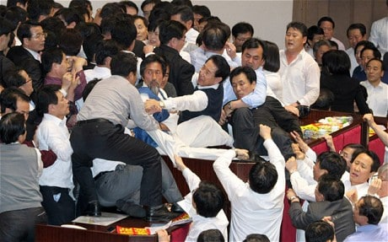

Slide 26


Slide 27
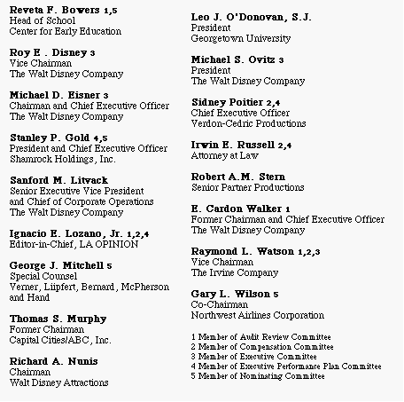
Who’s on Board? The Disney Experience - 1997
Notes:
17 people decide what you are having for dinner tonight.
This may be going back in time but it may help understanding Disney’s present standing. This was Disney’s board at the height of Michael Eisner’s powers. (Eisner became CEO of Disney in 1985 and consolidated power in the years after.)
Note the number of insiders on the board. (Seven out of 16; five current employees & two ex-employees) Also note the presence of Mr. Eisner’s private attorney (Irwin Russell) and the principal of his childrens’ elementary school (Reveta Bowers) on the board.
How independent was this board likely to be of Mr. Eisner? This may explain some of the actions taken by Disney (and specifically Eisner) during the 1990s… (Read Disney War by James Stewart for the gory details)
When Eisner was hired in 1984, he insisted on bringing in his protégé Jeffrey Katzenberg, his young assistant, into the firm with him. He put Katzenberg in charge of Disney Animation, which was not doing well. Katzenberg was largely responsible for the rebirth of that division (which Eisner had considered shutting down) with The Little Mermaid, Beauty and the Beast and The Lion King all proving to be mega-winners. As a reward for this success, Eisner fired him. His lucrative contract entitled him to 2% of the revenues from the movies he made in posterity but he would have settled for $100 million. Eisner refused to pay; Disney paid $ 250 million in 1999.
In 1995, Eisner hired Ovitz, a leading agent in Hollywood, and then told the board to okay the hire. He regretted it almost immediately and fired him 453 days later for “lying” and “incompetence”. However, rather than argue that this was just cause for firing, he paid Ovitz $ 100 million to leave.

Slide 28
Who’s on Board? The Disney Experience - 1997
Notes:
Football game but the goaly of the other team is your own guy… What a coincidence! Rubber-stamp board.
This may be going back in time but it may help understanding Disney’s present standing. This was Disney’s board at the height of Michael Eisner’s powers. (Eisner became CEO of Disney in 1985 and consolidated power in the years after.)
Note the number of insiders on the board. (Seven out of 16; five current employees & two ex-employees) Also note the presence of Mr. Eisner’s private attorney (Irwin Russell) and the principal of his childrens’ elementary school (Reveta Bowers) on the board.
How independent was this board likely to be of Mr. Eisner? This may explain some of the actions taken by Disney (and specifically Eisner) during the 1990s… (Read Disney War by James Stewart for the gory details)
When Eisner was hired in 1984, he insisted on bringing in his PA Jeffrey Katzenberg (joke: PA tell you where you live, who your wife is, etc. before iphones and ipads and alexa), his young assistant, into the firm with him. He put Katzenberg in charge of Disney Animation, which was not doing well. Katzenberg was largely responsible for the rebirth of that division (which Eisner had considered shutting down) with The Little Mermaid, Beauty and the Beast and The Lion King all proving to be mega-winners. As a reward for this success, Eisner fired him. His lucrative contract entitled him to 2% of the revenues from the movies he made in posterity but he would have settled for $100 million. Eisner refused to pay; Disney paid $ 250 million in 1999.
In 1995, Eisner hired Ovitz, a leading agent in Hollywood, and then told the board to okay the hire. He regretted it almost immediately and fired him 453 days later for “lying” and “incompetence”. However, rather than argue that this was just cause for firing, he paid Ovitz $ 100 million to leave.

Slide 29
The CalPERS Tests for Independent Boards
CalPERS, the California Employees Pension fund, suggested three tests in 1997 of an independent board
Are a majority of the directors outside directors?
Is the chairman of the board independent of the company (and not the CEO of the company)?
Are the compensation and audit committees composed entirely of outsiders?
Disney was the only S&P 500 company to fail all three tests.
But conflicts of interest not uncommon: eBay case
Notes:
http://fortune.com/2014/03/21/the-real-problem-at-ebay-corporate-governance/
Calpers was one of the first institutional investors to pay attention to corporate governance. Every year, Calpers lists the 10 companies that were the worst culprits when it came to putting managerial interests over stockholder interests.
In the last twenty years, investors have become more aware of how important corporate governance is and there are an increasing number of services that focus on measuring and reporting on corporate governance.

Slide 30
So What’s Next?
When managers do not fear stockholders, they will often put their interests over stockholder interests
Over-paid compensations
Informational fraud
Self-interest
Takeover defenses
Overpaying on takeovers
Notes:
Compensation: 250k to 300k + pensions
Working hours: 4 hours/wk, more than decade ago. 2010 data no longer update. Most of time spent is meeting: when they meet they just meet and nothing good comes out of it…
Cross-board CEO…

Slide 31
Stockholding and the Governance of the Firm
Managers are not significant stockholders in the firm: Significant potential for conflicts of interest between managers and stockholders.
Individuals are significant stockholders in the firm as well as part of top management: Smaller potential for conflict between managers and stockholders, but potential for conflict between inside stockholders and outside stockholders.
The government is a large stockholder (or a stockholder with veto power). This may keep managers in some check but it will create potential conflicts of interest between the other stockholders and the government
Trusts or descendants of owners are significant stockholders in the firm but are not an active part of incumbent management. Power that these stockholders retain to replace managers reduces potential for conflict of interest but is reduced as holdings get diluted among lots of family members.
Institutional investors. Active managed funds believed to lead to better governance but the latest evidence says no…. (see further reading in the last slide)
Notes:
https://www.youtube.com/watch?v=yJxiYK4NS00&list=PL8tJiHbTijTMHf7IucuGFrhlr50GWWZFz&index=5

Slide 32
Without further information, you are MOST likely to be able to act on your own self-interest as the manager of which one of following companies?
A closely held small company where the managers are also the founders of the firm
A state-owned company
A family-owned business but with none of the family members managing the business-owned company
A listed company on the London Stock Exchange with a largely diversified shareholder composition
Notes:
The correct answer is D. A manager of this type of company does not hold a significant share of the company, and hence falls into the first category of the previous slide.

Slide 33
Not the end of the story…
Shareholders vs. bond (debt) holders
Different characteristics of stocks and bonds (L3)
Disciplinary role of debt (L8)
Firms vs. financial markets
“Efficient” market?
Firms vs. community/society/environment
Notes:
In each of these cases, you are likely to see stock prices go up on the action and bond prices go down. Lenders value stability and security. Equity investors share in upside and may prefer to cash out…

Slide 34
Evidence that managers delay bad news
Notes:
This study looked at thousands of earnings and dividend announcements, categorized by day of the week in the 1980s. Either bad things tend to happen on Fridays, or managers are trying to hold on to bad news until Friday. In fact, most of the bad news on Friday comes out after 4 pm, and markets have closed.
Managers do not trust markets to not panic on bad news.
This may explain a portion of the weekend effect - stock prices tend to go down on Mondays.

Slide 35
Further reading
Passive investors are good corporate stewards, Financial Times 19 Jan 2016 (http://www.ft.com/cms/s/0/c4e7a4f6-be8a-11e5-846f-79b0e3d20eaf.html#axzz3ySsfcvyE)
Notes:
https://www.youtube.com/watch?v=fsSIoGaF-8A&list=PL8tJiHbTijTMHf7IucuGFrhlr50GWWZFz

Slide 36
Summary
Pros and cons of corporation
Real/financial assets
Objective of corporate financial management: narrow/wide terms
Conflicts of interest between corporate ownership and management
Some simple cases and remedies of such conflicts

